Slide 1


Digital ORACLE financial specialist
"Digital Egypt Pioneers"

Slide 2
Table of Content:
1- Introduction
2- Banking , Treasury and cash management
3-Oracle cash management
4- Difference between using old way and using oracle .
5- Challenges and Considerations
6- The Future of Banking and Treasury with Oracle
7- conclusion

Slide 3

Enterprise Resource Planning
(ERP)
An ERP (Enterprise Resource Planning) system is integrated software that helps organizations manage and automate core business processes.
Common ERP Solutions:
Some popular ERP solutions include:
. SAP
. Oracle
. Microsoft Dynamics 365
. NetSuite
. Infor

Slide 4

Banking , Treasury and cash management in Oracle
Banks are under pressure to optimize returns on investments due to market volatility, low interest rates, higher financial risks, and evolving regulations. They need to balance investments and profits, minimize risks and losses, and ensure regulatory compliance. The treasury department is crucial in achieving this balance by optimizing investment management, capital market operations, liquidity, and risk management.
However, banks face several challenges in their treasury operations, including:
· Managing multiple investment classes
· Poor visibility and control
· Complex, rigid, and manual processes
· Information discrepancies
To overcome these challenges, banks must transform their treasury back-office operations. Implementing the right treasury management system is key to achieving this transformation.

Slide 5
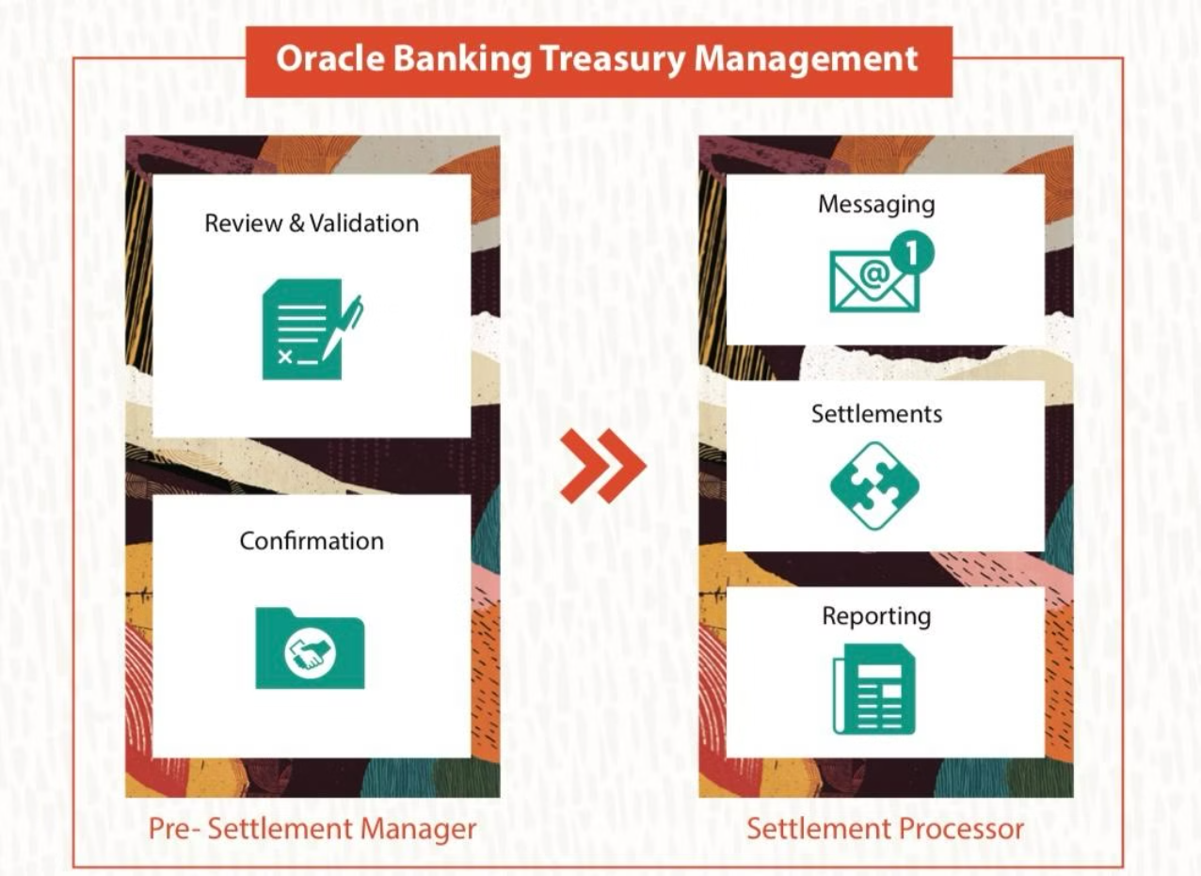

Slide 6
Optimizing Treasury Management with Oracle
Cash Flow Optimization
Risk Management
Automation & Efficiency
Robust risk management capabilities help identify, assess, and mitigate financial risks, ensuring regulatory compliance and supporting strategic decision-making.
Oracle's treasury management solutions enable real-time visibility and control over cash positions, facilitating smarter liquidity management and improved cash forecasting.
Streamlined reconciliation, reporting, and workflow automation improve productivity and enable treasury teams to focus on strategic initiatives.

Slide 7

Automating Reconciliation and Reporting
Reconciliation Automation
Customized Reporting
Flexible reporting capabilities enable treasury teams to generate insightful, real-time reports tailored to their specific needs.
Oracle's solutions leverage machine learning to automate bank reconciliation, reducing errors and accelerating the close process.
Audit Trail and Compliance
Increased Productivity
Automating repetitive tasks and streamlining workflows allow treasury professionals to focus on strategic initiatives.
Robust audit trails and compliance features help ensure adherence to regulatory requirements and support risk management.

Slide 8

Difference between using old way and using oracle
1
Traditional Methods
2
Using Oracle Cash Management and Banking:
Manual Processes:
Automation:
Limited Visibility.
Real-time Insights.
Fragmented .
Integrated System .
Labor-Intensive .
Enhanced Security payments and transactions.
Inflexibility.
Scalability and Flexibility.
3
conclusion
Advanced analytics and reporting capabilities provide treasury professionals with the data-driven insights needed to drive strategic decision-making.

Slide 9





Challenges and Considerations
Complex Setup:
Integration Issues:
Need for Comprehensive Training:
Customization Limitations:
The initial setup can be intricate, requiring technical expertise.
Integrating with other systems may lead to data discrepancies if not managed properly.
Certain unique organizational needs may not be fully addressed by Oracle’s standard features.
Users may require extensive training to fully utilize Oracle’s features.

Slide 10





Leveraging AI-Powered Analytics
Predictive Insights
Risk Monitoring
Oracle's AI-driven analytics deliver predictive insights to help anticipate cash flow patterns, optimize liquidity, and support strategic planning.
Intelligent risk monitoring and forecasting capabilities enable proactive risk mitigation and compliance management.
Workflow Automation
Customized Reporting
Oracle's solutions leverage AI and machine learning to automate repetitive tasks, enhance productivity, and reduce operational errors.
Flexible, AI-powered reporting features enable the creation of insightful, data-driven reports tailored to the unique needs of treasury teams.

Slide 11

The Future of Banking and Treasury with Oracle
Oracle's integrated banking and treasury solutions are designed to empower financial institutions to navigate the evolving landscape of the banking industry. By leveraging AI, automation, and advanced analytics, Oracle's platform helps treasury teams drive operational excellence, manage risks, and unlock new opportuni.

Slide 12
conclusion
Oracle provides comprehensive solutions for banking and treasury management.
●Its tools help institutions manage risk, enhance cash flow visibility, and automate operations.
●Call to Action: Consider adopting Oracle solutions to transform your financial management processes for greater efficiency and security

Slide 13

Team
salma Ahmed Abdel-latef
Manar Abdelbadea
safwa Badr Eldeen
Weam Mohamed
Razan Hossam Hassan
Menna Tallah Antar Yossef
Mennatullah Mohamed Abdelsalem

Slide 14
Thank you

